Slide 1
Referral info

Slide 2
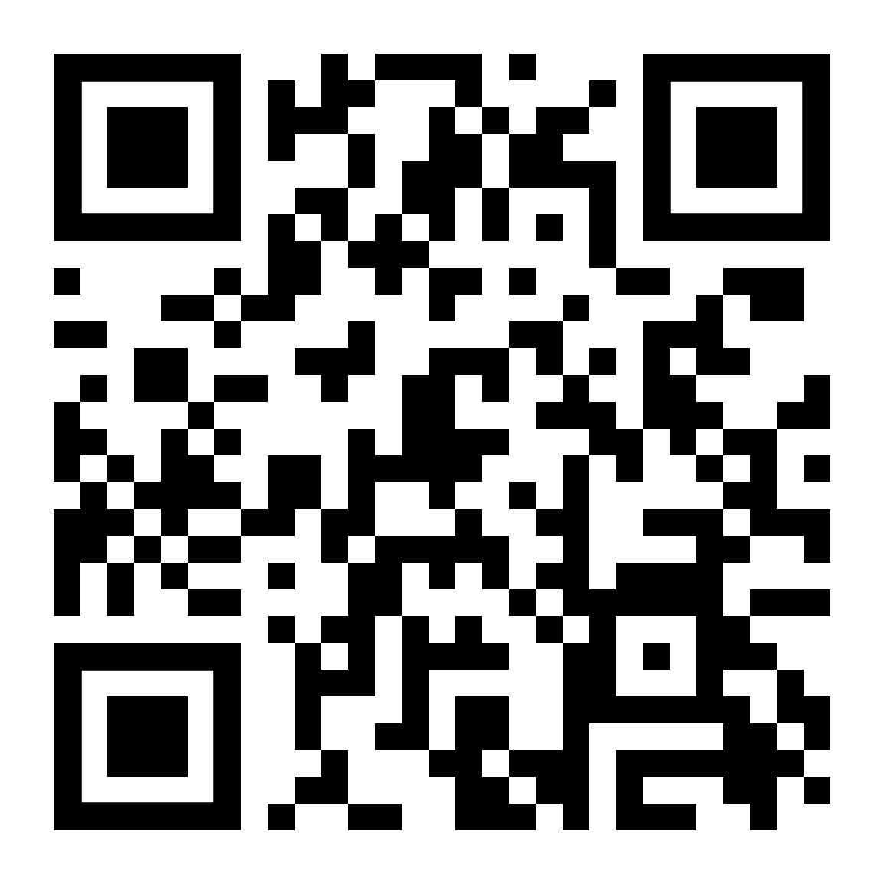
How to access support:
NECA Gambling – Neca
Self Referrals Telephone: 0191 562 3309 NECA Website/QR code | Professional Referrals Telephone: 0191 562 3309 NECA Website/QR code Referral form via CJSM gambling.referrals.northeast@neca.cjsm.net | Helpline Referrals 24 hours 0808 8020 133

Slide 3
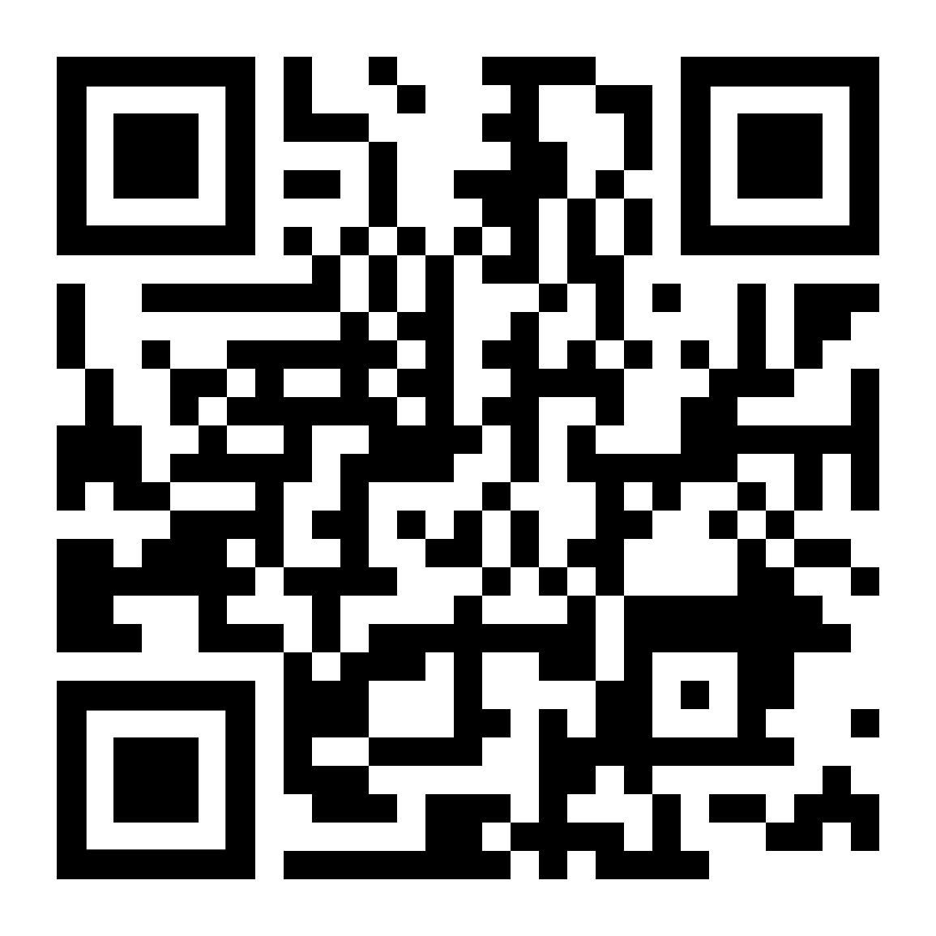
Referral
Treatment
Review
Referral into NECA via;
External (i.e. GP)
Self-Referral
National Gambling Helpline
Triage/Assessment
Client to be contacted within 24-48 hours to complete initial assessment.
Appointment offered, usually within 1 week of referral. This can be face to face, telephone or virtual.
Clients offered ongoing appointments with regular reviews.
Once discharged clients will receive 3, 6 and 12 month follow ups, with the option to contact NECA / their practitioner for further support at any time.
A variety of treatment options are available including ; PSI intervention, Support Groups, Signposting, Extended BI, Care coordination, Relapse prevention.
Referrals to external services/partnerships may be made, with consent, according to client need.
The Client Journey
Tel: 0191 562 3309 (North-East) / 01423 740 723 (Yorkshire & Humber)
Visit www.neca.co.uk
To complete a referral scan the QR code
In partnership with
Notes:
One to One therapeutic support for people with gambling problems and affected others.
Peer support groups for individuals in recovery from problem gambling and affected others
RELAPSE PREVENTION Programme which provides strategies to support and enable individuals to anticipate and cope with the potential for relapse.
BRIEF INTERVENTION Awareness and strategies around the physical and psychological impact of gambling.
SIGN POSTING Signposting onto relevant other organisations for further support outside of the remit of direct gambling support. E.g housing support, debt management
SELF-HELP RESOURCES Helpful and interactive resources to assist anyone who has recognised that gambling may is an issue in their life . E.g., blocking software, self-help workbooks.
Tier 4 referral for rehad – Gordon Moody and Adreriad for dual diagnosis eg drugs/alcohol and the Hurley Group

Slide 4
Gambling Related
Harms Champion

Slide 5
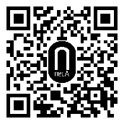
Telephone NECA
on 0191 5623309
Referral via
our website: www.neca.co.uk

